Slide 1


DigiWill Midterm Presentation
Jannik Möll, Robin Kuck, Morten Harter, Christian Schweigel
December 12, 2018

Slide 2
Agenda
Vision
General Vision
Use Cases & Scope
Documentation
Methodology
RUP
YouTrack
Enviornment & Quality
Architecture
Configuration Management
Version Control, Continuous Integration
IDE Integration Tools
Showcase
Demo
UI-Tests

Slide 3

Vision

Slide 4
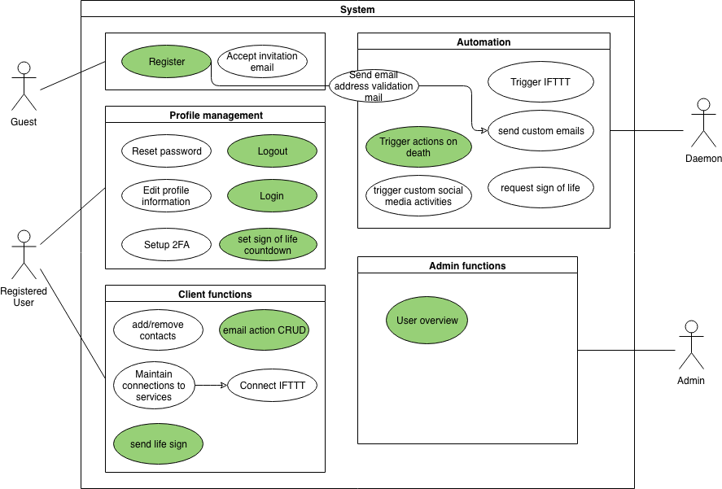
Use Cases & Scope

Slide 5
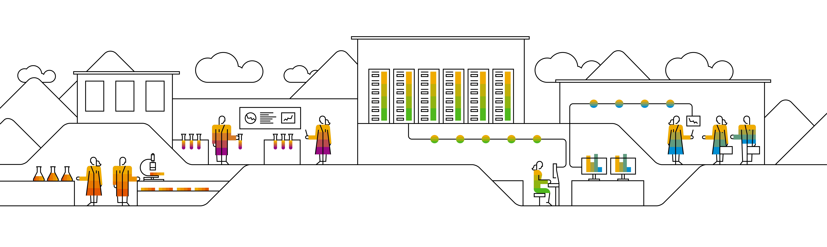
Methodology

Slide 6
RUP Team Roles
Jannik Möll
Project Manager
Architect/Designer
Morten Harter
Tool Specialist
Test-Designer
Robin Kuck
Front-End Developer (Implementer)
Configuration Manager
Christian Schweigel
Back-End Developer (Implementer)
Tool Specialist

Slide 7
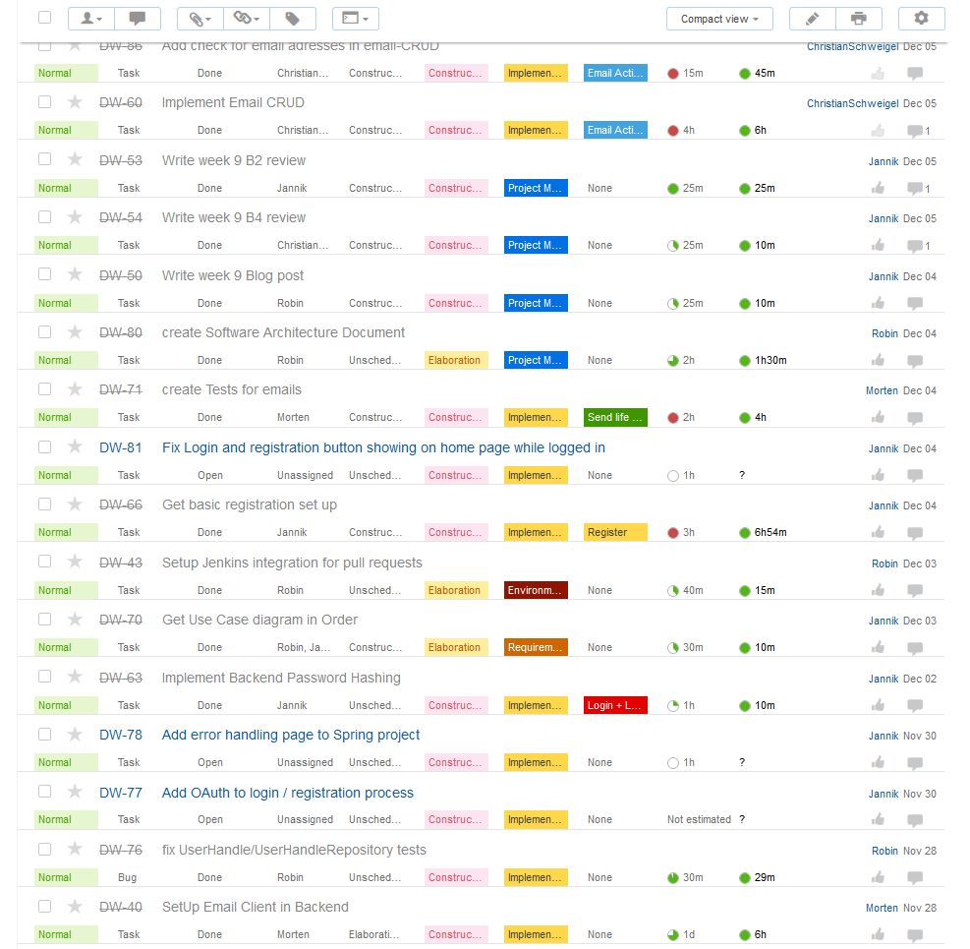
YouTrack Issue List

Slide 8
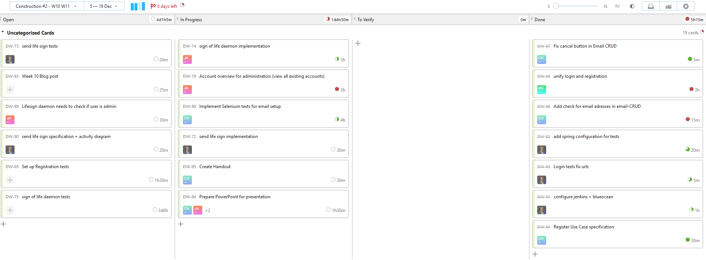
YouTrack Agile Board

Slide 9
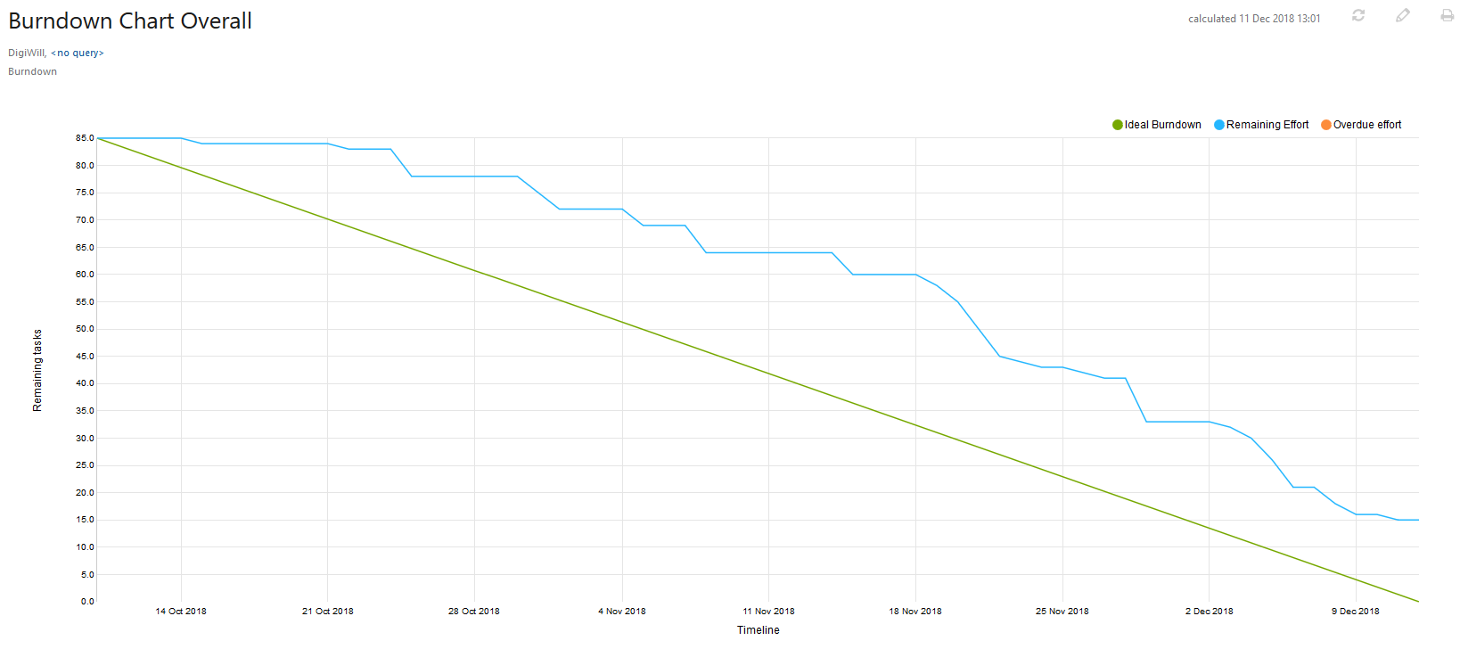
YouTrack Burndown Chart

Slide 10
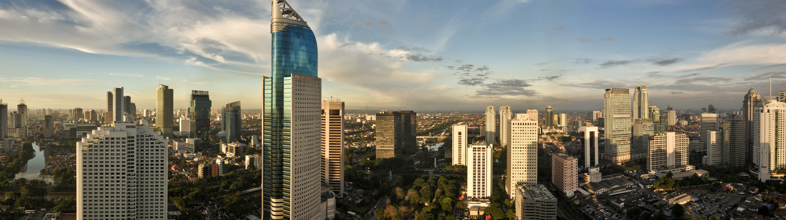
Architecture

Slide 11
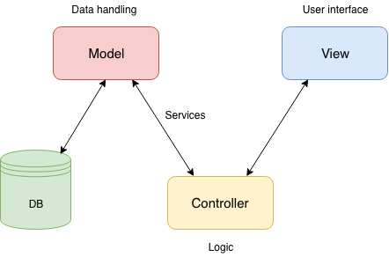
MVC Architecture

Slide 12
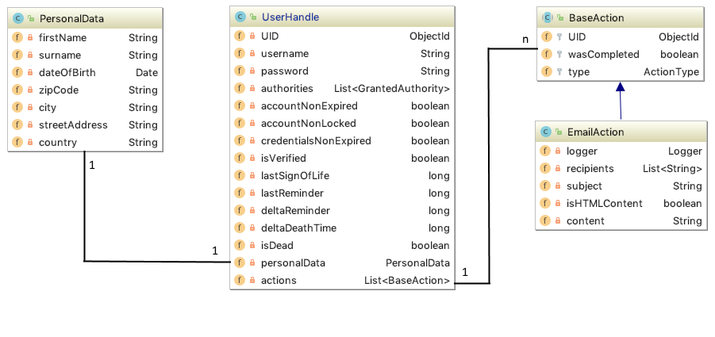
Database Architecture

Slide 13
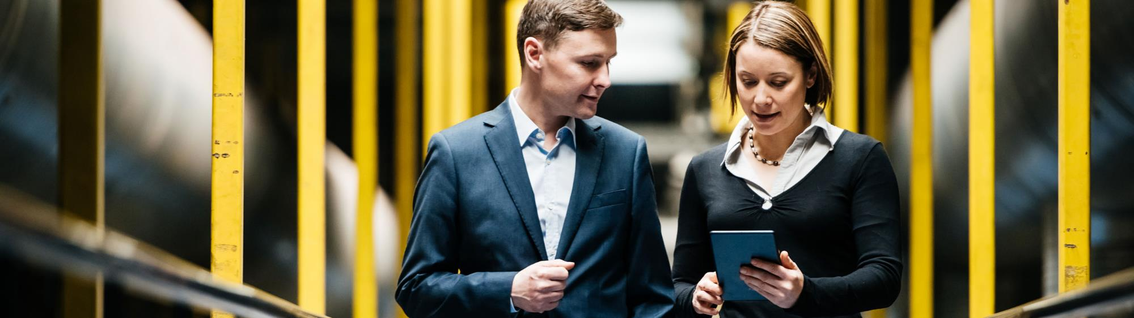
Configuration Management

Slide 14
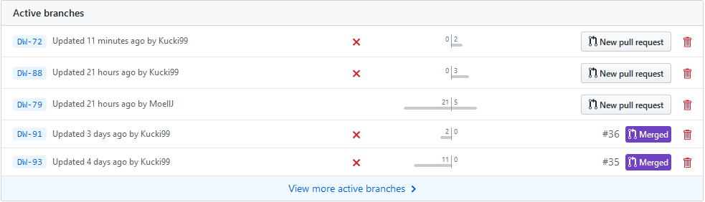
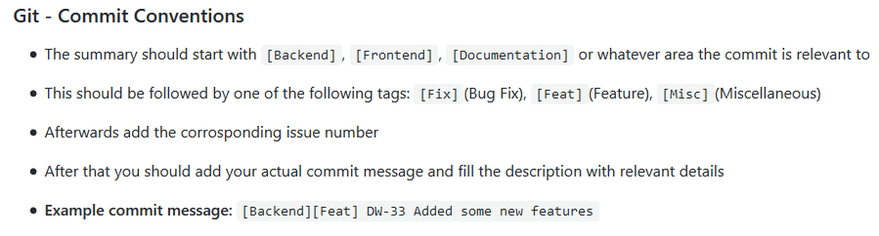
Version Control Git

Slide 15
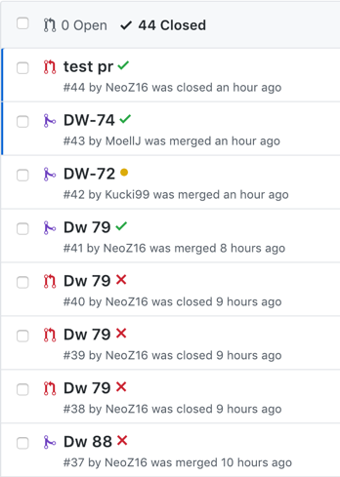
Version Control Github
Merging issue branches with Pull Requests

Slide 16
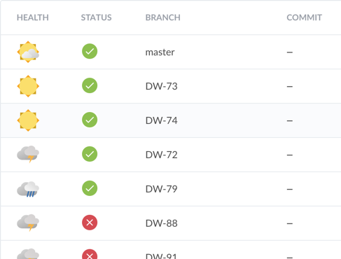
Continuous Integration Jenkins – Blue Ocean
Pull Requests and Branches are built and tested by Jenkins
Merging only allowed when build was successfull

Slide 17
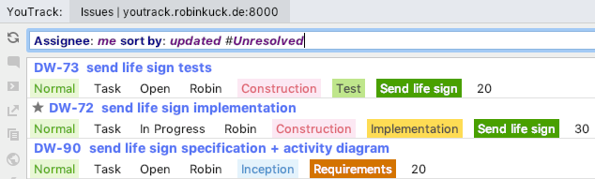
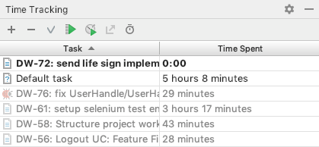
IDE Integration Tools Time Tracking Plugin
View issues
Automatic time tracking while coding

Slide 18
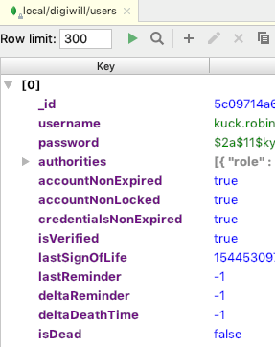
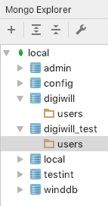
IDE Integration Tools Mongo Explorer Plugin
View, insert and update database

Slide 19
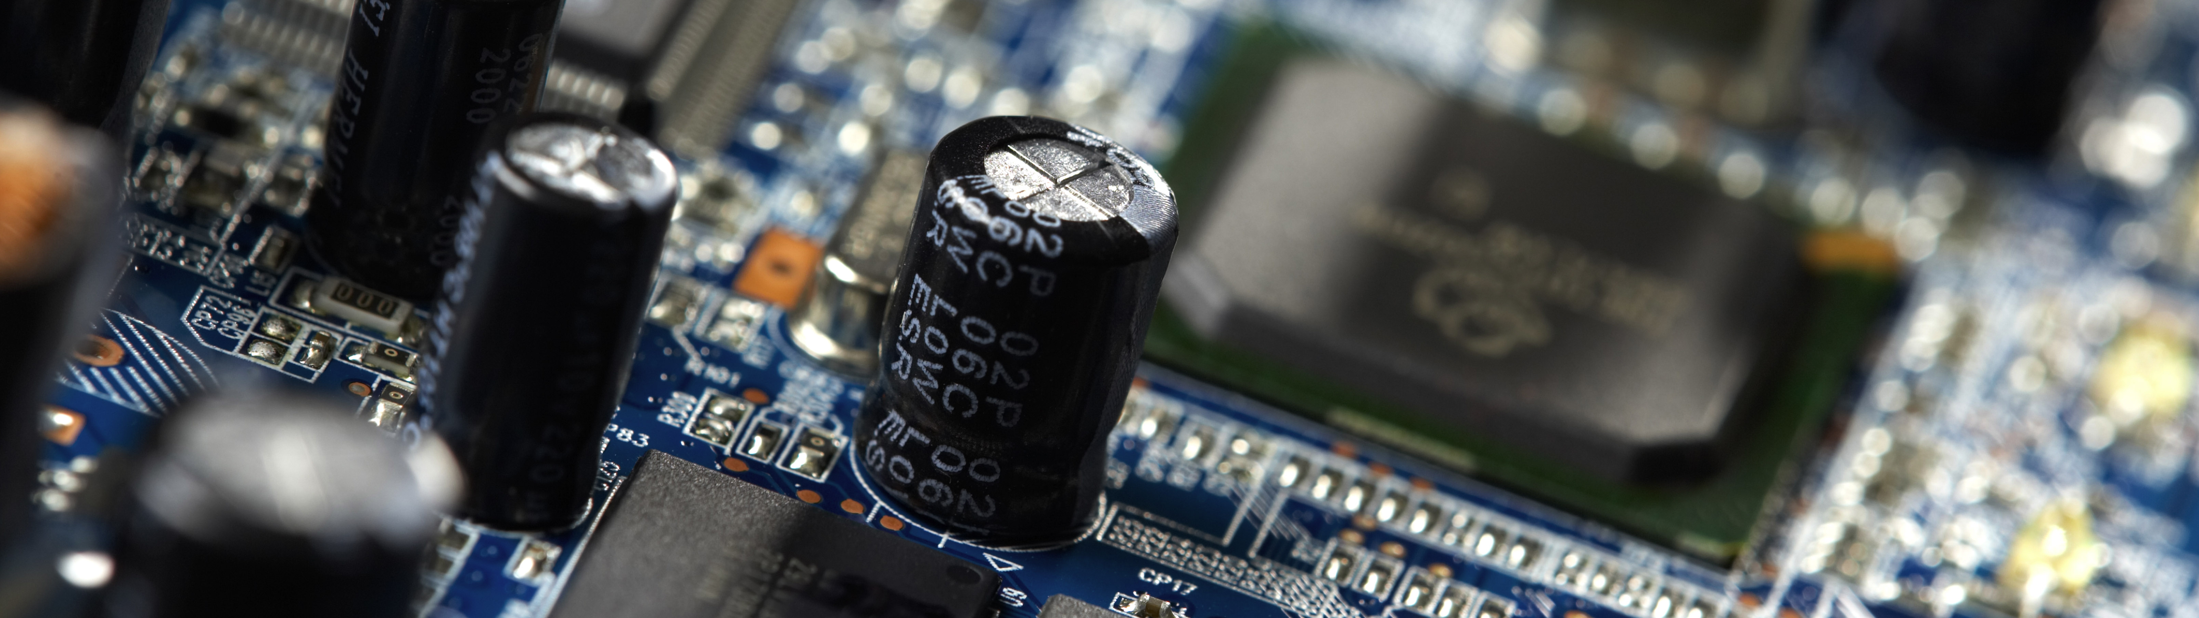
Live Demo & UI Tests

Slide 20
Thank you.
Contact information:
Jannik Möll
Project Manager
jannik.moell@sap.com
Partner logo

